Slide 1
Cost Concepts

Slide 2
Opportunity Cost
Opportunity cost is the cost of a good or service as measured by the alternative uses that are foregone by producing the good or service.
  If 15 bicycles could be produced with the materials used to produce an automobile, the opportunity cost of the automobile is 15 bicycles.
The price of a good or service often may reflect its opportunity cost.

Slide 3
Short Run versus Long Run
Short Run
  A time period when at least one input, such as plant size, cannot be changed
  Plant Size
    The physical size of the factories that a firm owns and operates to produce its output

Slide 4
Short Run versus Long Run
Long Run
  The time period in which all factors of production can be varied

Slide 5
Short Run versus Long Run
Managers take account of both the short-run and long-run consequences of their behavior.
While making decisions about what
to do today, tomorrow, and next week—they keep an eye on the long-run benefits.

Slide 6
The Relationship Between Output and Inputs
Average Physical Product
  Total product divided by the variable input

Slide 7
The Relationship Between Output and Inputs
Marginal Physical Product
  The physical output that is due to the addition of one more unit of a variable factor of production
  The change in total product occurring when a variable input is increased and all other inputs are held constant
  Also called marginal product

Slide 8
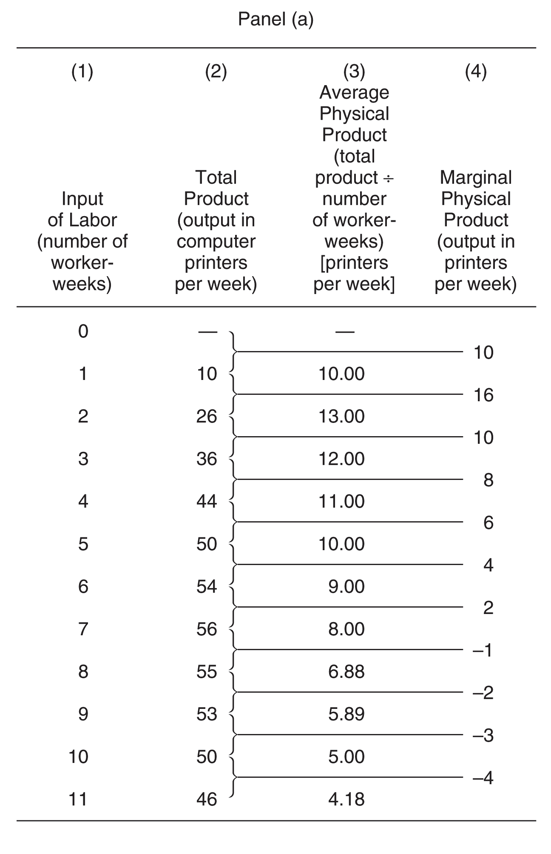
The Production
Function and Marginal Product:
A Hypothetical Case, Panel (a)

Slide 9
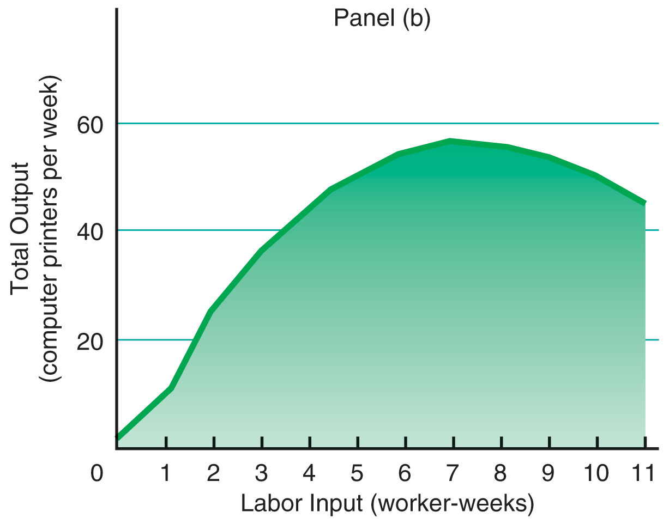
The Production
Function and Marginal Product:
A Hypothetical Case

Slide 10
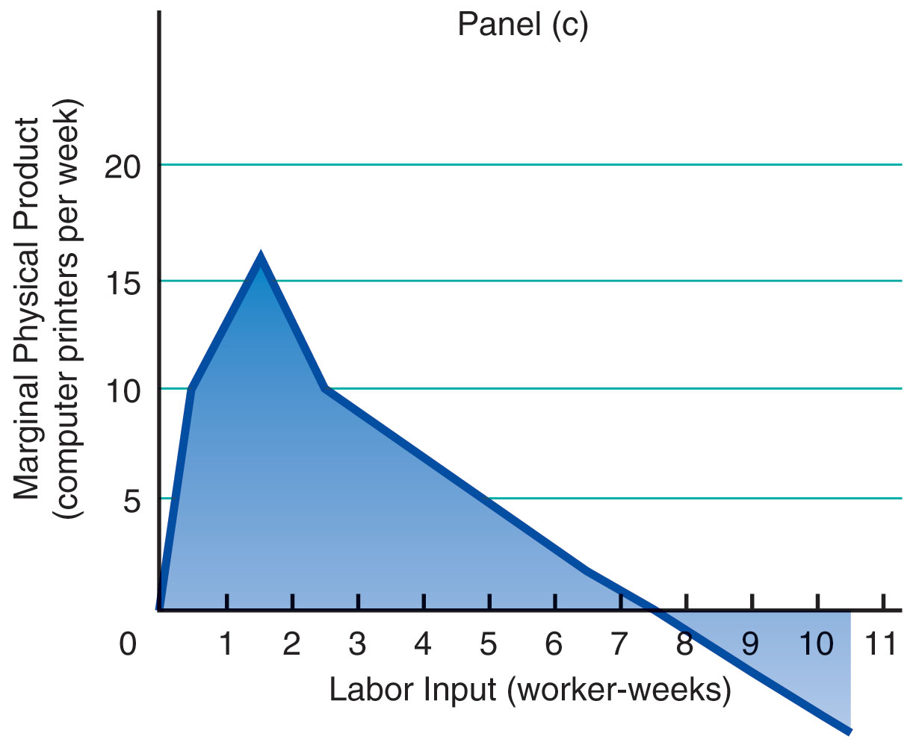
The Production
Function and Marginal Product:
A Hypothetical Case

Slide 11
Diminishing Marginal
Product
Law of Diminishing Marginal Product
  The observation that after some point, successive equal-sized increases in a variable factor of production, such as labor, added to fixed factors of production, will result in smaller increases in output

Slide 12
Short-Run Costs to the Firm
Total Costs
  The sum of total fixed costs and total
  variable costs
Fixed Costs
  Costs that do not vary with output
Variable Costs
  Costs that vary with the rate of production
Total costs (TC) = TFC + TVC

Slide 13
Short-Run Costs to the Firm
Average Total Costs (ATC)
Total costs (TC)
Average total costs (ATC) =
Output (Q)

Slide 14
Short-Run Costs to the Firm
Average Variable Costs (AVC)
Total variable costs (TVC)
Average variable costs (AVC) =
Output (Q)

Slide 15
Short-Run Costs to the Firm
Average Fixed Costs (AFC)
Total fixed costs (TFC)
Average fixed costs (AFC) =
Output (Q)

Slide 16
Short-Run Costs to the Firm
Marginal Cost
  The change in total costs due to a one-unit change in production rate
Change in total cost
Marginal costs (MC) =
Change in output

Slide 17
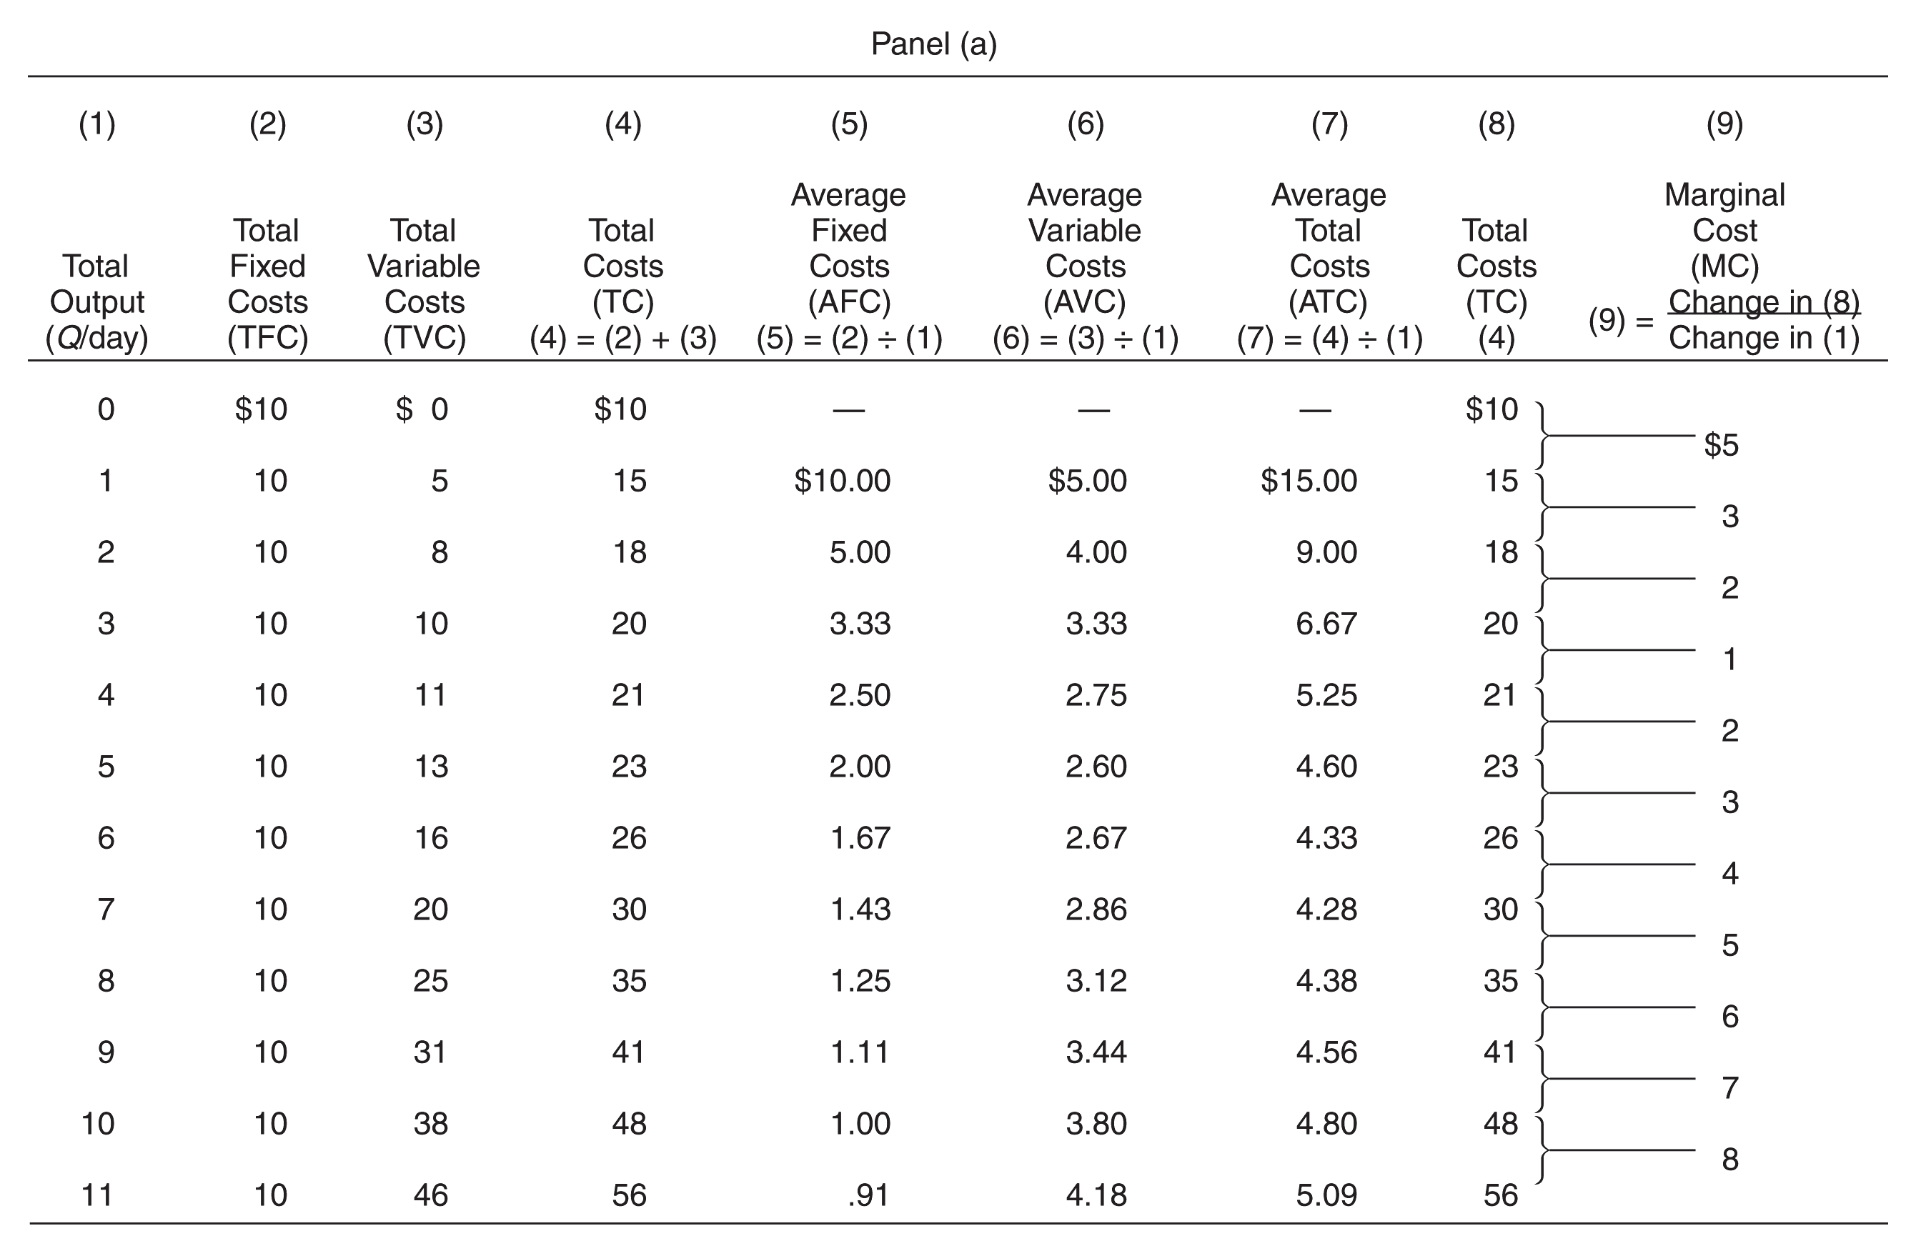
Cost of Production: An Example

Slide 18
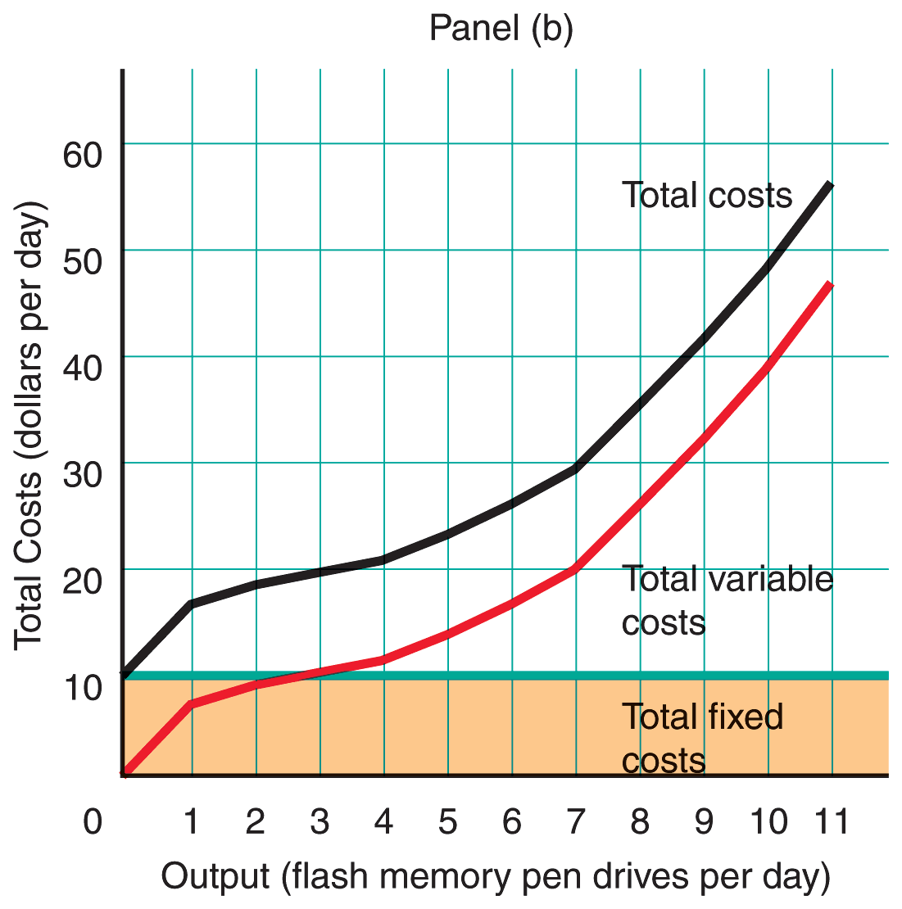
Cost of Production: An Example

Slide 19
Short-Run Costs to the Firm
Question
  What do you think—is there a predictable relationship between the production function and AVC, ATC, and MC?

Slide 20
Short-Run Costs to the Firm
Answer
  As long as marginal physical product rises, marginal cost will fall, and when marginal physical product starts to fall (after reaching the point of diminishing marginal product), marginal cost will begin to rise.

Slide 21
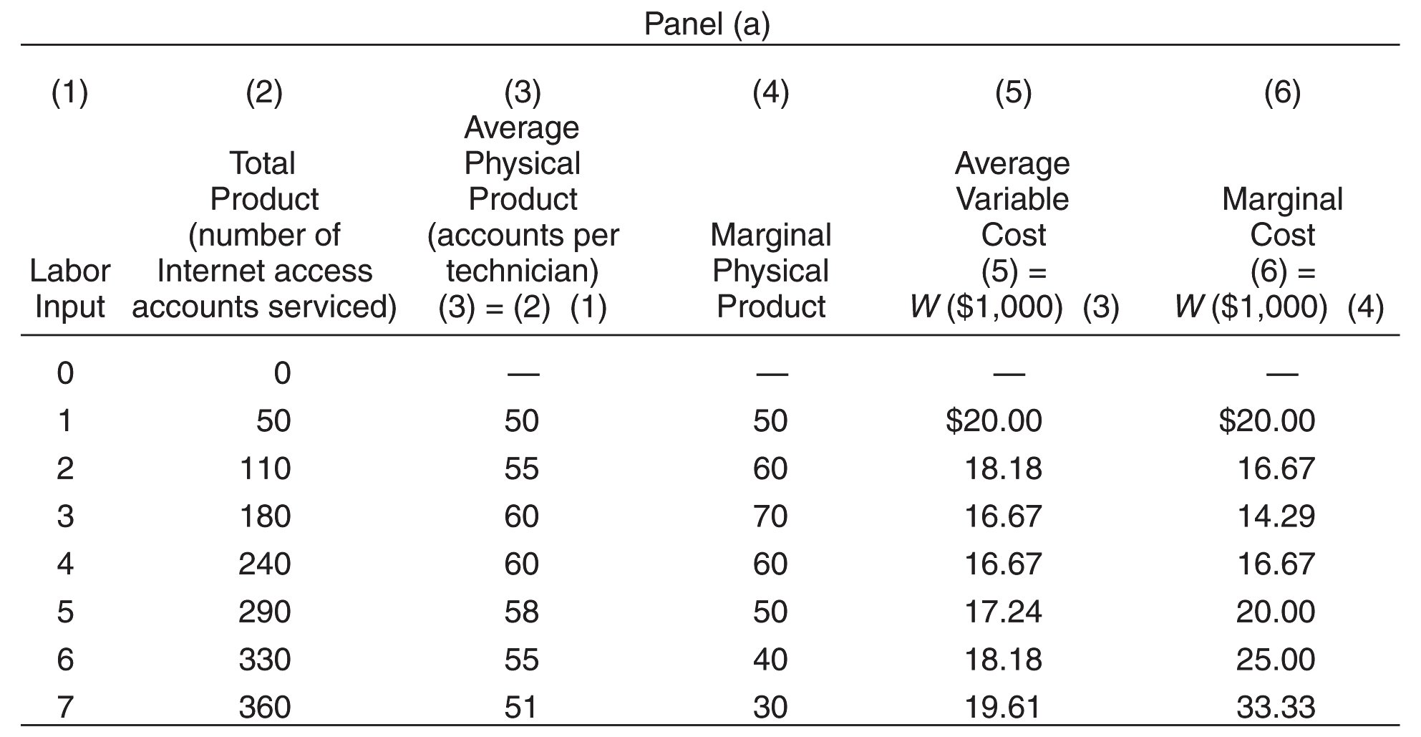
The Relationship Between Output and Costs
/
/
/

